Slide 1
UVM Knowledge Presentation and UVM TB Examples
Jinfeng.Huang
2018/01/03

Slide 2
Agenda
UVM knowledge
UVM TB transfer from SV TB
UG for Polestar SoC env.
Q & A

Slide 3
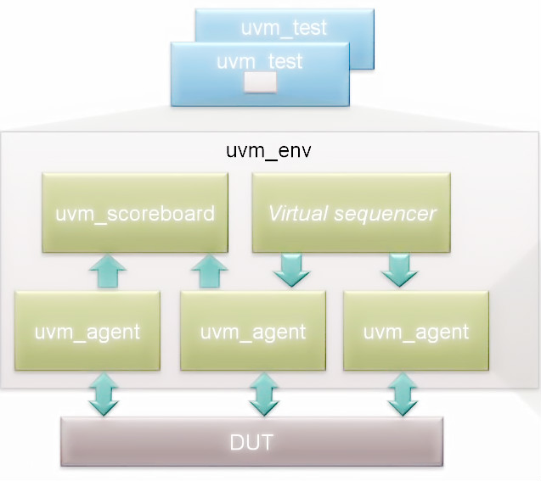
Why UVM?
Supports constrained random, coverage-driven verfication
Standardized messaging, TLM, Register Layer etc.
Reuse- Verification IP, verification env, tests, knowhow etc.
Supported by all major simulator vendors
A standard approach - consistency and uniformity

Slide 4
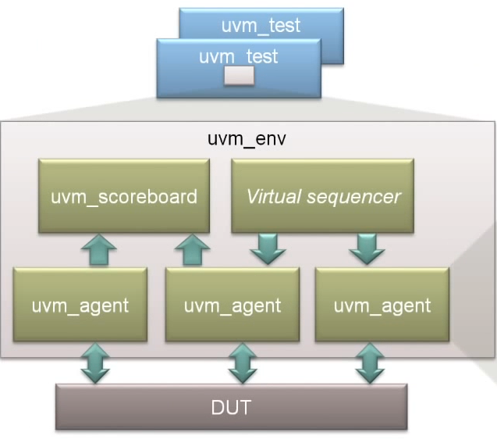
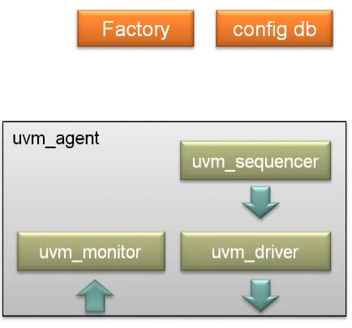
The big picture

Slide 5
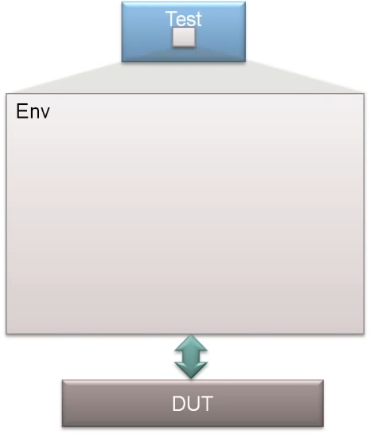
UVM Hello world
class
class
interface
module

Slide 6
Interface and DUT
interface dut_if ;
...
endinterface
module top;
...
dut_if dut_if1 ();
dut dut1 (.dif(dut_if1));
...
endmodule
module dut (dut_if dif) ;
endmodule

Slide 7
The Env and Test (1)
class my_env extends uvm_env;
`uvm_component_utils(my_env)
function new(string name, uvm_component parent);
super.new(name, parent);
endfunction
endclass
class my_test extends uvm_test;
`uvm_component_utils(my_test)
my_env m_env;
function new(string name, uvm_component parent);
super.new(name, parent);
endfunction
function void build_phase(uvm_phase phase);
m_env = my_env::type_id::create(“m_env”, this);
endfunction
endclass

Slide 8
The Env and Test (2)
class my_test extends uvm_test;
...
function void build_phase(uvm_phase phase);
m_env = my_env::type_id::create(“m_env”, this);
endfunction
task main_phase(uvm_phase phase);
phase.raise_objection(this);
#10;
`uvm_info(“my_test”, “Hello World”, UVM_MEDIUM)
phase.drop_objection(this);
endtask
...
endclass

Slide 9
Package and Running the Test
`include “uvm_macros.svh”
package my_pkg;
import uvm_pkg::*;
...
`include “my_env.sv”
`include “my_test_pkg.svh”
...
endclass
module top;
import uvm_pkg::*;
import my_pkg::*;
...
dut_if dut_if1 ();
dut dut1 (.dif(dut_if1));
...
initial begin
run_test(“my_test”);
end
...
endmodule
<sim options> ... +UVM_TESTNAME=testname

Slide 10
Operation mechanism
interface dut_if ;
...
endinterface
`include “uvm_macros.svh”
package my_pkg;
import uvm_pkg::*;
class my_env extends uvm_env;
`uvm_component_utils(my_env)
...
endclass
class my_test extends uvm_test;
`uvm_component_utils(my_test)
// construct function
function void build_phase(uvm_phase phase);
m_env = my_env::type_id::create(“m_env”, this);
endfunction
task main_phase(uvm_phase phase);
phase.raise_objection(this);
#10;
`uvm_info(“my_test”, “Hello World”, UVM_MEDIUM)
phase.drop_objection(this);
endtask
endclass
...
endpackage : my_pkg
module dut (dut_if dif) ;
...
endmodule
module top;
import uvm_pkg::*;
import my_pkg::*;
...
dut_if dut_if1 ();
dut dut1 (.dif(dut_if1));
...
initial begin
run_test(“my_test”);
end
...
endmodule

Slide 11
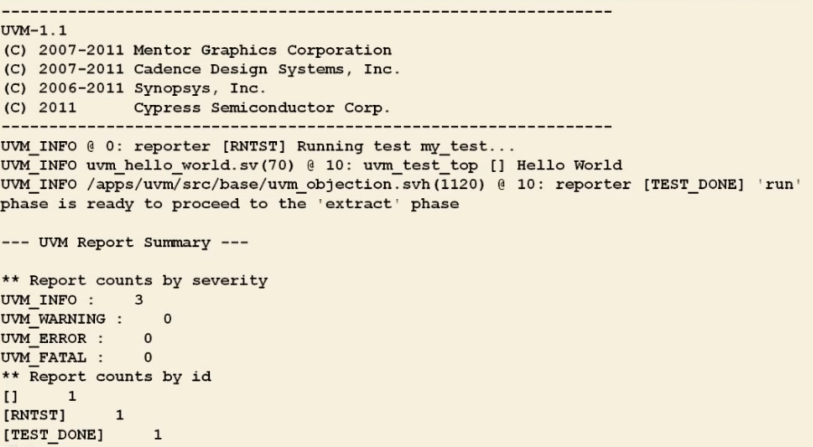
Run options and result
setenv UVM_HOME ${VCS_HOME}/etc/uvm
vcs -sverilog -CFLAGS -DVCS \
+incdir+${UVM_HOME}/src \
${UVM_HOME}/src/dpi/uvm_dpi.cc \

Slide 12
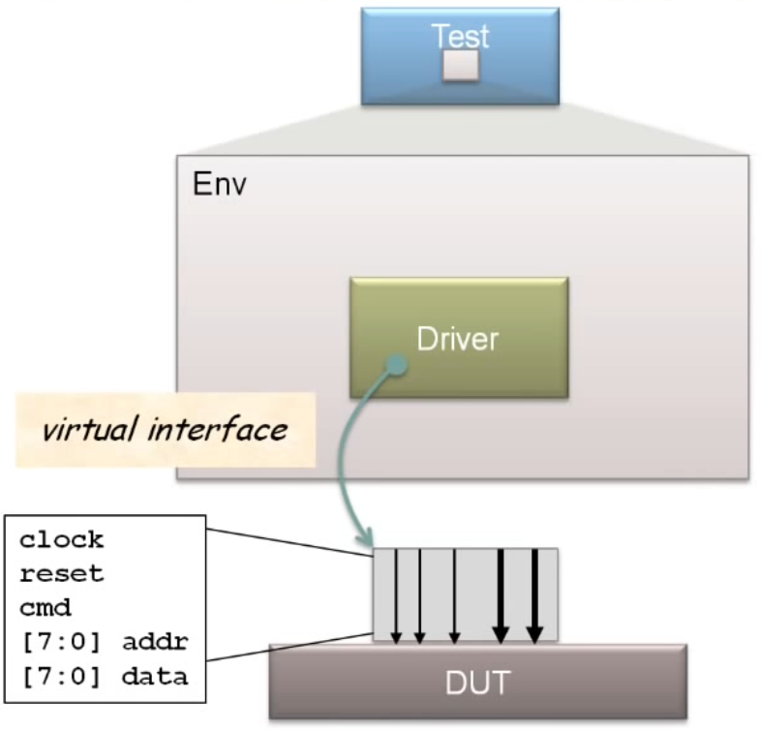
Config Database (1)
class
class
interface
module

Slide 13
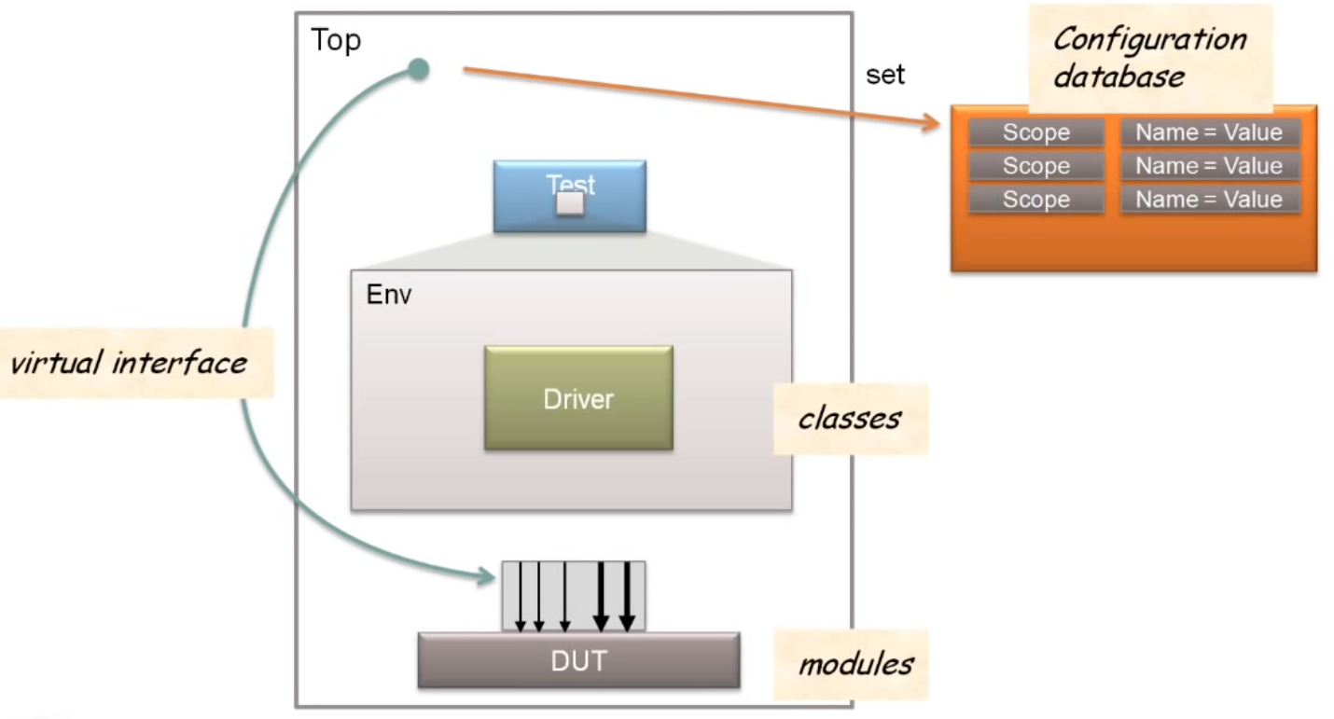

Config Database (2)

Slide 14
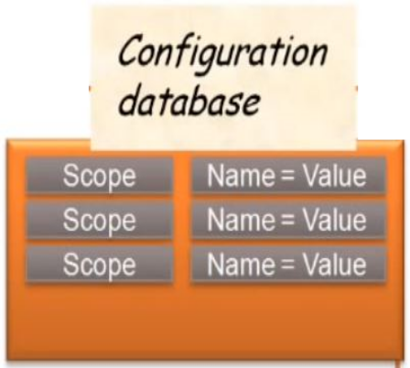
Config Database (3) -- set
module top;
import uvm_pkg::*;
import my_pkg::*;
...
dut_if dut_if1 ();
dut dut1 (.dif(dut_if1));
...
initial begin
uvm_config_db #(virtual dut_if)::set(null, “uvm_test_top.m_env.*”, “dut_if”, dut_if1);
run_test(“my_test”);
end
...
endmodule
Type
Caller
Path
Name
Value

Slide 15
Config Database (3) -- get
class my_driver extends uvm_driver;
`uvm_component_utils(my_driver)
virtual dut_if dut_vi;
function new(string name, uvm_component parent);
super.new(name, parent);
endfunction
function void build_phase(uvm_phase phase);
if (!
uvm_config_db #(virtual dut_if)::get(this, “”, “dut_if”, dut_vi)
)
`uvm_error(“”; “uvm_config_db::get failed”)
endfunction
...
endclass
Type
Caller
Path
Name
Value

Slide 16
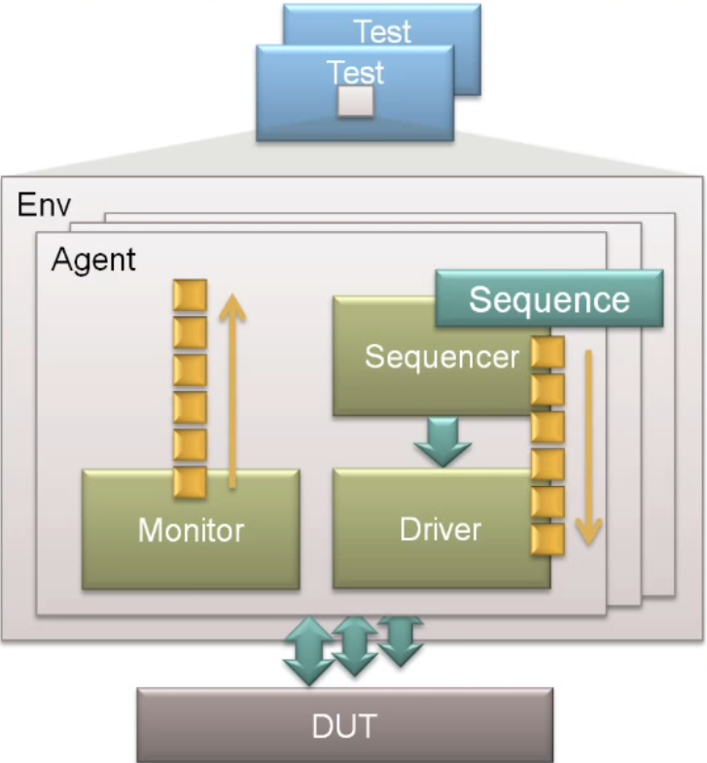
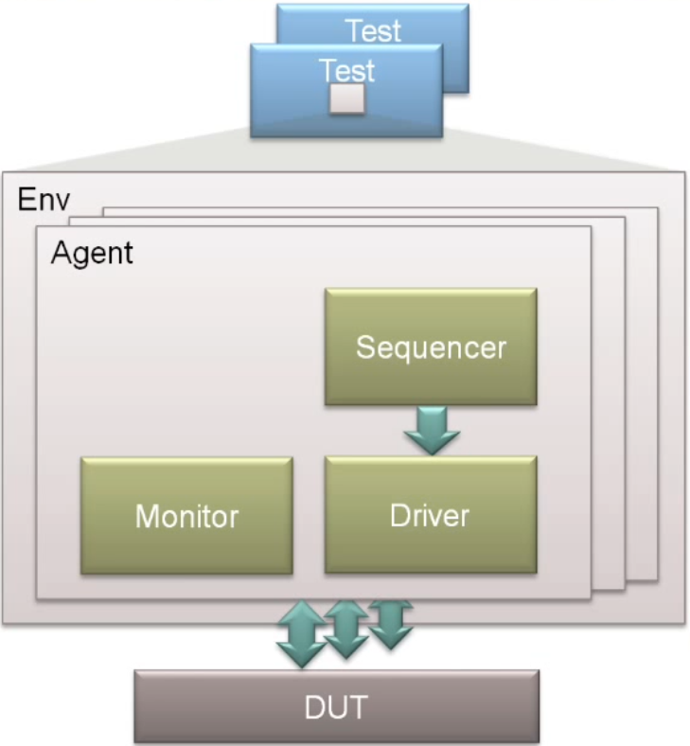
Agent Architecture
Checking
and Coverage
Constrained random stimulus generation
Agent-per-interface

Slide 17
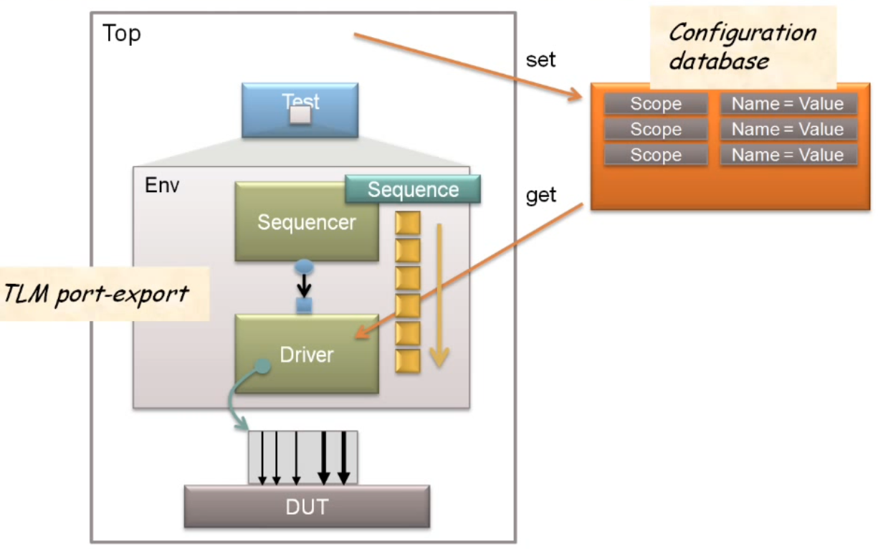
Sequencer-Driver Communication
m_drv.seq_item_port.connect(m_sqr.seq_item_export);

Slide 18
Transaction (1)
class my_transaction extends uvm_sequence_item;
`uvm_object_utils(my_transaction)
rand bit cmd;
rand int addr;
rand int data;
constraint c_addr { addr >= 0; addr < 256;}
constraint c_data { data >= 0; data < 256;}
function new(string name = “”);
super.new(name);
endfunction
...
endclass

Slide 19
Transaction (2) -- Methods
class my_transaction extends uvm_sequence_item;
`uvm_object_utils(my_transaction)
...
function string convert2string;
return $sformatf(“ cmd=%0b, addr=%0d, data=%0d”, cmd, addr, data);
endfunction
...
endclass
extern function void copy(uvm_object rhs);
extern function bit compare(uvm_object rhs, uvm_comparer comparer=null);
extern function int pack_bytes/pack_ints/pack(ref byte/int unsigned/bit bytestream[]);
extern function int unpack_bytes/unpack_ints/unpack(ref byte/int unsigned/bit bytestream[]);

Slide 20
Sequence
typedef uvm_sequencer #(my_transaction) my_sequencer;
class my_sequence extends uvm_sequence #(my_transaction);
`uvm_object_utils(my_sequence)
extern function new(string name = “”);
task body;
if(starting_phase != null) starting_phase.raise_objection(this);
repeat(8) begin
req = my_transaction::type_id::create(“req”);
start_item(req);
if(!req.randomize()) `uvm_error(“”; “Randomize failed”)
finish_item(req);
end
if(starting_phase != null) starting_phase.drop_objection(this);
endtask
endclass

Slide 21
Driver Main Phase
class my_driver extends uvm_driver #(my_transaction);
`uvm_component_utils(my_driver)
...
task main_phase (uvm_phase phase);
forever begin
seq_item_port.get_next_item(req);
@ (posedge dut_vi.clock);
dut_vi.cmd = req.cmd;
dut_vi.addr = req.addr;
dut_vi.data = req.data;
seq_item_port.item_done();
end
endtask
...
endclass
Waits for start_item
Return from finish_item

Slide 22
Sequence-Driver Handshake
Sequence
Driver
repeat(8) begin
req = my_transaction::type_id::create(“req”);
start_item(req);
if(!req.randomize())
`uvm_error(“”; “Randomize failed”)
finish_item(req);
end
forever begin
seq_item_port.get_next_item(req);
@ (posedge dut_vi.clock);
dut_vi.cmd = req.cmd;
dut_vi.addr = req.addr;
dut_vi.data = req.data;
seq_item_port.item_done();
end

Slide 23
Sequence-Driver Connection
class my_env extends uvm_env;
`uvm_component_utils(my_env)
my_sequencer m_sqr;
my_driver m_drv;
function new(string name, uvm_component parent);
super.new(name, parent);
endfunction
function void build_phase(uvm_phase phase);
m_sqr = my_sequencer::type_id::create(“m_sqr”, this);
m_drv = my_driver ::type_id::create(“m_drv”, this);
endfunction
function void connect_phase(uvm_phase phase);
m_drv.seq_item_port.connect(m_sqr.seq_item_export);
endfunction
endclass

Slide 24
Starting the Sequence
class my_test extends uvm_test;
`uvm_component_utils(my_test)
...
my_env m_env;
...
task main_phase(uvm_phase phase);
my_sequence m_seq;
m_seq = my_sequence::type_id::create(“m_seq”);
if( !req.randomize() )
`uvm_error(“”; “Randomize failed”)
seq.starting_phase = phase;
seq.start( m_env.m_sqr );
endtask
...
endclass
build_phase()
uvm_config_db #(uvm_object_wrapper)::set(this,
“m_env.m_agt.m_sqr.main_phase”,
“default_seq”,
my_sequence::type_id::get())
set_type_override_type()

Slide 25
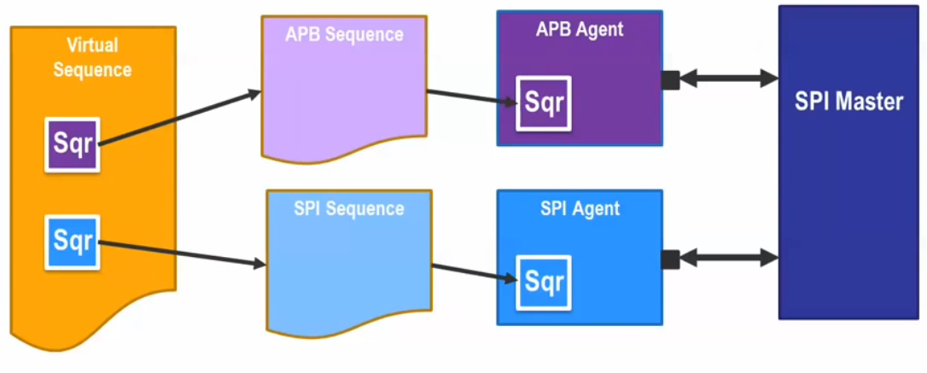
Virtual Sequences
Contains handles for multiple sequencers
Executes multiple sequences in series and/or parallel
Does not generate sequence_item

Slide 26
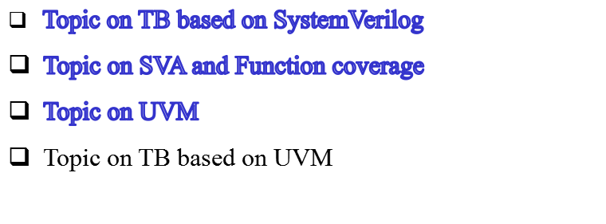
Till now ...

Slide 27
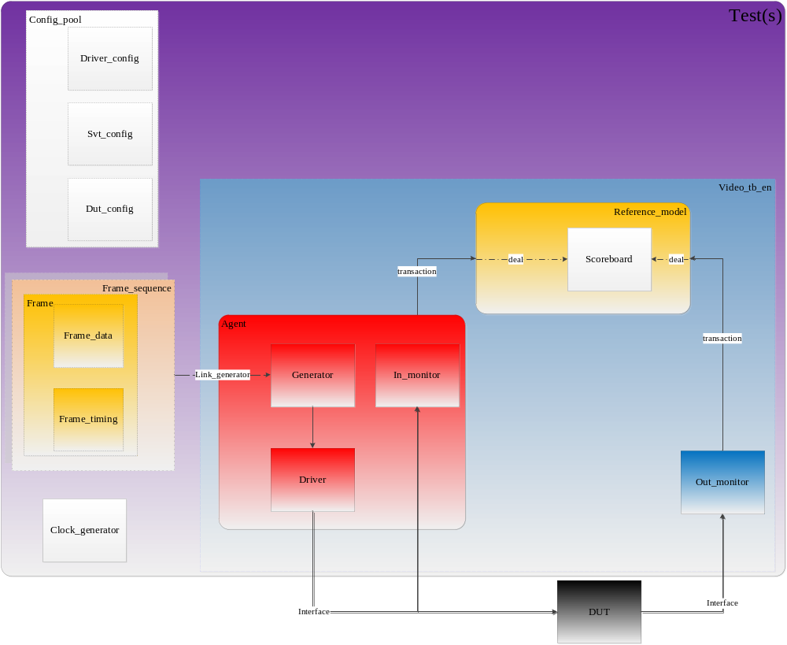
UVM TB transfer from SV TB

Slide 28
Components
Frame_Agent: container of driver, generator and in_monitor
Frame_Driver: request transaction from generator, trans it to pin level signal
Frame_Generator: get transactions, and deliver it to driver
Frame_Monitor: source monitor, detect the input signals, and send the pixel data(in transaction level) to reference model
Out_Monitor: output monitor, detect the DUT output signals, and send the pixel data(in transaction level) to reference model
Frame_Refm: gen golden pixel as needed, and submit transaction to scoreboard
Frame_Scoreboard: compare the frame pixel data)

Slide 29
Objects
Config_pool: container of driver_config , svt_config and dut_config
Driver_config: source video timing config, clock config, etc.
SVT_config: source video timing only
dut_config: dut variable config, dut register setting
Clock_generator: produce the clocks according to the setting of Driver_config. Take it as PLL.
Frame : container of frame_data and frame_timing, an information for one frame
Frame_data: pixel value of frame
Frame_timing: timing information for frame. Including resolution, front porch, back porch, etc.

Slide 30
Randomize
resoultion type: from file, from command, from constraint randomize
pixel value: from file, absolutely randomize
format and color depth
link lane num and link clock
Contiuning...

Slide 31
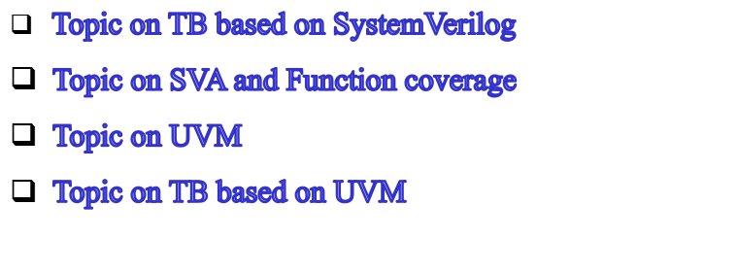
Till now ...

Slide 32
Q&A
Thank you!

